Slide 1

Domain ML
Technology: Python
UPI FRAUD DETECTION USING MACHINE LEARNING

Slide 2
INDEX
Implementation
Model Implementation
Algorithm Definition
Project Description
Problem Statement
Objective
Scope
Proposed System
Literature Survey
Architecture
UML Diagrams
Resource Requirements

Slide 3
ABSTRACT
With the rapid adoption of Unified Payments Interface (UPI) for digital transactions, the risk of fraudulent activities has also increased significantly. To address this challenge, we propose a novel approach to detect UPI fraud by analyzing transaction details such as the bank book name, transaction ID, and transaction amount. Our method employs three machine learning algorithms: Random Forest, K-Nearest Neighbors (KNN), and Decision Tree.The Random Forest classifier is known for its accuracy and resilience against overfitting, making it a robust choice for this application. It processes the provided transaction details to classify the transaction outcome as either "Transaction Failed: Incorrect Details Entered" or "Transaction Successful: Details Verified and Processed."In addition to Random Forest, the KNN algorithm provides a straightforward approach to classification based on the similarity of transaction details with previously labeled data. The Decision Tree algorithm, with its intuitive structure, offers clear decision-making pathways, enhancing interpretability.

Slide 4
ABSTRACT
This multi-algorithm approach not only helps in preventing fraudulent transactions but also ensures that legitimate transactions are processed smoothly. The proposed model aims to enhance the security of UPI transactions, providing users with an additional layer of protection against unauthorized activities. Initial evaluations suggest that these algorithms effectively distinguish between genuine and fraudulent transactions, demonstrating their potential for integration into real-world financial systems.
Keywords: UPI Digital Payments, Random Forest Algorithm, K-Nearest Neighbors, Decision Tree, Machine Learning

Slide 5
OBJECTIVE OF PROJECT
Development of Fraud Detection System: The project focuses on creating a robust fraud detection system specifically for Unified Payments Interface (UPI) transactions, analyzing critical details like bank book name, transaction ID, and transaction amount.
Machine Learning Algorithms: We aim to implement a framework using machine learning algorithms, including Random Forest, K-Nearest Neighbors (KNN), and Decision Tree, to effectively classify transactions as either fraudulent or successful.
Accuracy and Minimized False Positives: The goal is to enhance the accuracy of fraud detection while minimizing false positives, ensuring that legitimate transactions are not incorrectly flagged.
Integration into Financial Systems: Ultimately, the proposed model will be integrated into real-world financial systems, providing users with increased protection against unauthorized transactions and fostering confidence in digital payment processes

Slide 6
PROBLEM STATEMENT
With the rapid adoption of the Unified Payments Interface (UPI) for digital transactions, the increasing incidence of fraudulent activities poses a significant challenge to financial security. The complexity of transaction details, such as bank book names, transaction IDs, and amounts, creates opportunities for unauthorized transactions. To mitigate this risk, we propose a novel approach for detecting UPI fraud by leveraging machine learning techniques. Our system employs a combination of Random Forest, K-Nearest Neighbors (KNN), and Decision Tree classifiers to analyze transaction data. These algorithms are known for their effectiveness in classification tasks. enabling the system to accurately identify whether a transaction is "Transaction Failed: Incorrect Details Entered" or "Transaction Successful: Details Verified and Processed."

Slide 7
MOTIVATION
Project Motivation: The increasing convenience of Unified Payments Interface (UPI) has led to a surge in fraudulent activities, prompting the need for an effective fraud detection system to protect users and financial institutions.
Machine Learning Algorithms: The project utilizes Random Forest, K-Nearest Neighbors (KNN), and Decision Tree algorithms to analyze transaction details like bank book name, transaction ID, and amount.
Algorithm Benefits: Random Forest enhances accuracy by mitigating overfitting, KNN provides straightforward classification through similarity, and Decision Trees facilitate clear decision-making.
Project Goal: This multi-algorithm approach aims to secure UPI transactions, fostering user trust in digital payment systems.

Slide 8
SCOPE
Objective: Develop a robust system for detecting fraud in Unified Payments Interface (UPI) transactions by analyzing transaction details like bank book name, transaction ID, and amount.
Algorithms: Implement and evaluate three machine learning algorithms: Random Forest, K-Nearest Neighbors (KNN), and Decision Tree for classifying transactions.
Classification Outcomes: Classify transactions as either "Transaction Failed: Incorrect Details Entered" or "Transaction Successful: Details Verified and Processed."
Impact: Enhance UPI transaction security, increase user trust, and identify the most effective classifier for integration into financial systems to prevent fraud while ensuring smooth processing of legitimate transactions.

Slide 9
INTRODUCTION
With the rapid adoption of the Unified Payments Interface (UPI) for digital transactions, the associated risk of fraudulent activities has surged significantly. To combat this challenge, we propose a robust approach to detect UPI fraud by analyzing critical transaction details, including the bank book name, transaction ID, and transaction amount. Our method employs three machine learning algorithms: Random Forest, K-Nearest Neighbors (KNN), and Decision Tree. The Random Forest classifier is renowned for its accuracy and resistance to overfitting, making it a strong candidate for distinguishing between legitimate and fraudulent transactions. KNN offers an intuitive distance-based classification, while the Decision Tree provides a clear, interpretable model that facilitates decision-making. This ensemble of techniques classifies transaction outcomes as either "Transaction Failed: Incorrect Details Entered" or "Transaction Successful: Details Verified and Processed."

Slide 10
LITERATURE SURVEY
S.NO | YEAR | AUTHORS | TITLE | OUT COMES
1 | 2000 | ARTÍS M, AyUSO M, GUILLÉN M | Modeling different types of automobile insurance fraud behavior in the Spanish market | This study analyzes repeated choices in expensive automobile insurance policies using a four-year dataset, revealing significant factors like engine capacity, vehicle make, and consumer inertia in policy selection.
2 | 2008 | Hand C, Whitrow DJ, Adams C, Juszczak NM, Weston P D | Performance criteria for plastic card fraud detection | The paper discusses optimizing predictive data mining algorithms for fraud detection in plastic card transactions. It defines two performance measures related to cost minimization and fraud reduction, and introduces a plot for algorithm performance evaluation.

Slide 11
S.NO | YEAR | AUTHORS | TITLE | OUT COMES
3 | 2010 | Becker RA, Volinsky C, Wilks AR | Becker RA, Volinsky C, Wilks AR | This paper explores the evolution of fraud detection at AT&T, highlighting key fraud schemes and techniques, advocating for simple models, visualization, flexible environments, and the importance of data management and human involvement.
4 | 2016 | Abdallah A, Maarof MA, Zainal A | Fraud detection system: A survey. J Netw Computer Application | This survey paper examines issues in fraud detection systems (FDSs) within e-commerce, exploring challenges like concept drift and real-time detection, and discusses trends and approaches across five e-commerce systems.
5 | 2017 | Sahin M | Understanding Telephony Fraud as an Essential Step to Better Fight it | SIMBox fraud in telecommunications causes $3-$7 billion in annual losses by redirecting illegitimate VoIP traffic. This study investigates its impact, detection approaches, and flaws from 1994 to 2021.

Slide 12
EXISTING SYSTEM
K-Nearest Neighbors (KNN) is a simple, non-parametric algorithm used for both classification and regression tasks. It operates by finding the 'k' closest data points (neighbors) to a query point and making predictions based on the majority class (for classification) or average value (for regression) of these neighbors. The algorithm is intuitive and easy to implement but can be computationally expensive, especially with large datasets, because it requires calculating the distance between the query point and all other points in the dataset. Additionally, KNN's performance can be heavily influenced by the choice of 'k' and the distance metric used, and it is sensitive to irrelevant or noisy features, which can mislead the distance calculations and reduce its accuracy. Despite these limitations, KNN is widely used due to its simplicity and effectiveness in certain scenarios.

Slide 13
DISADVANTAGES
Data Sensitivity: Existing systems may struggle with noisy or irrelevant features, which can lead to inaccurate predictions and decreased performance.
Scalability Issues: Algorithms like KNN can become computationally expensive with large datasets, resulting in slower response times and inefficiencies in real-time applications.
Overfitting Risk: While Random Forest is robust, decision trees can easily overfit to training data, leading to poor generalization on unseen transactions
Limited Interpretability: Although Decision Trees provide some level of interpretability, ensemble methods like Random Forest can be less transparent, making it harder for users to understand the decision-making process.
Imbalanced Data: Fraud detection systems often deal with imbalanced datasets, leading to biased predictions favoring legitimate transactions over fraudulent ones.

Slide 14
PROPOSED SYSTEM
Random Forest is a powerful machine learning algorithm that can be highly effective in detecting UPI fraud. It operates by building multiple decision trees during training and combining their predictions to make a final decision. This ensemble method improves accuracy and reduces the risk of overfitting, making it well-suited for complex tasks like fraud detection where the data can be noisy, imbalanced, and involve intricate relationships between features. In the context of UPI fraud detection, Random Forest can analyze various transaction attributes such as the bank book name, transaction ID, and amount, identifying patterns that distinguish between legitimate and fraudulent transactions. By leveraging the combined power of multiple trees, Random Forest can capture the subtle indicators of fraud that might be missed by simpler models.

Slide 15
ADVANTAGES
Enhanced Accuracy: Utilizing Random Forest, KNN, and Decision Tree algorithms improves classification accuracy by leveraging the strengths of each model, reducing the likelihood of false positives and negatives.
Robustness Against Overfitting: Random Forest's ensemble approach mitigates overfitting, making the system resilient to noisy and imbalanced transaction data.
Interpretability: Decision Trees provide clear decision-making pathways, allowing users to understand the rationale behind classification outcomes, which is crucial for trust in financial systems.
Real-time Detection: The system can analyze transaction details in real time, enabling swift identification and prevention of fraudulent activities.
Flexibility: The multi-algorithm approach can adapt to evolving fraud patterns by retraining with new data, ensuring continued effectiveness.

Slide 16
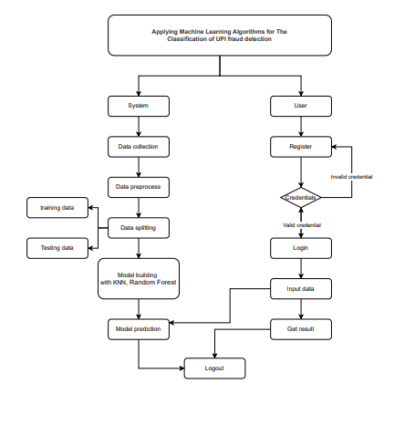
BLOCK DIAGRAM

Slide 17
Resource Requirements
Hardware
Processor: I5/Intel Processor, RAM: 8GB (min), Hard Disk: 128 GB, Key Board: Standard Windows Keyboard, Mouse: Two or Three Button Mouse)
01
Resources
02
Software
(Operating System: Windows 10, Programming Language: Python 3.10.8, IDE: VS Code)
03
Packages/Libraries
(Streamlit, Sklearn, Transformers, Tensorflow, Pandas, Seaborn, Speech Recognition

Slide 18
FUNCTIONAL AND NON-FUNCTIONAL REQUIREMENTS
Requirement’s analysis is very critical process that enables the success of a system or software project to be assessed. Requirements are generally split into two types: Functional and non-functional requirements.
Functional Requirements: These are the requirements that the end user specifically demands as basic facilities that the system should offer. All these functionalities need to be necessarily incorporated into the system as a part of the contract. These are represented or stated in the form of input to be given to the system, the operation performed and the output expected. They are basically the requirements stated by the user which one can see directly in the final product, unlike the non-functional requirements.

Slide 19
FUNCTIONAL AND NON-FUNCTIONAL REQUIREMENTS
Examples of functional requirements:
Authentication of user whenever he/she logs into the system
System shutdown in case of a cyber-attack
A verification email is sent to user whenever he/she register for the first time on some software system.
Non-functional requirements: These are basically the quality constraints that the system must satisfy according to the project contract. The priority or extent to which these factors are implemented varies from one project to other. They are also called non-behavioral requirements.

Slide 20
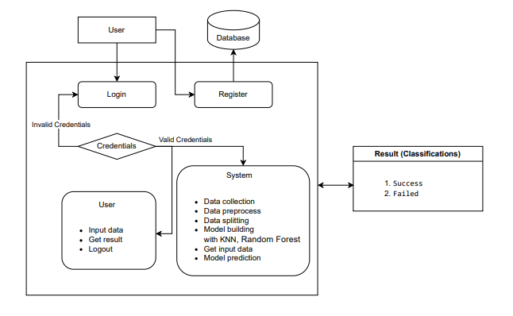
ARCHITECTURE

Slide 21
Use Case Diagram:
1) A use case diagram in the Unified Modeling Language (UML) is a type of behavioral diagram defined by and created from a Use-case analysis.
2) Its purpose is to present a graphical overview of the functionality provided by a system in terms of actors, their goals (represented as use cases), and any dependencies between those use cases.
3) The main purpose of a use case diagram is to show what system functions are performed for which actor. Roles of the actors in the system can be depicted.

Slide 22
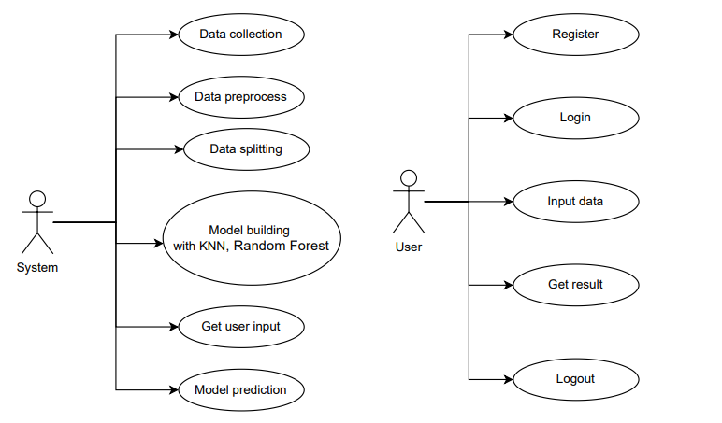
Figure: Use Case diagram

Slide 23
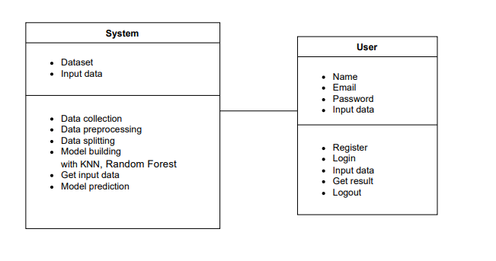
Class Diagram:
In software engineering, a class diagram in the Unified Modeling Language (UML) is a type of static structure diagram that describes the structure of a system by showing the system's classes, their attributes, operations (or methods), and the relationships among the classes. It explains which class contains information

Slide 24
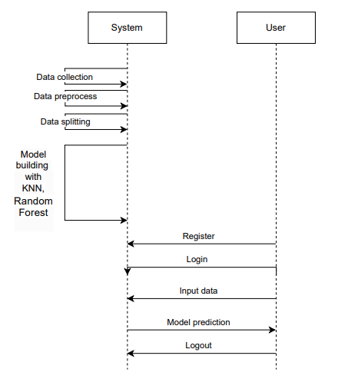
Sequence Diagram:
A sequence diagram in Unified Modeling Language (UML) is a kind of interaction diagram that shows how processes operate with one another and in what order.
It is a construct of a Message Sequence Chart. Sequence diagrams are sometimes called event diagrams, event scenarios, and timing diagrams
Figure: Sequence diagram

Slide 25
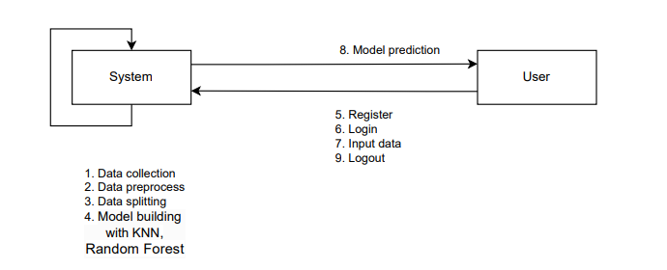
Collaboration Diagram:
In collaboration diagram the method call sequence is indicated by some numbering technique as shown below. The number indicates how the methods are called one after another. We have taken the same order management system to describe the collaboration diagram. The method calls are similar to that of a sequence diagram. But the difference is that the sequence diagram does not describe the object organization whereas the collaboration diagram shows the object organization.
Figure: Collaboration diagram

Slide 26
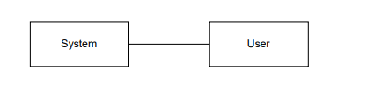
Deployment Diagram
Deployment diagram represents the deployment view of a system. It is related to the component diagram. Because the components are deployed using the deployment diagrams. A deployment diagram consists of nodes. Nodes are nothing but physical hardware’s used to deploy the application.
Figure: Deployment diagram

Slide 27
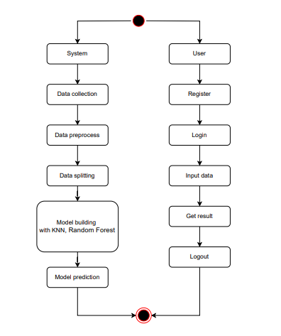
Activity Diagram:
Activity diagrams are graphical representations of workflows of stepwise activities and actions with support for choice, iteration and concurrency. In the Unified Modelling Language, activity diagrams can be used to describe the business and operational step-by-step workflows of components in a system. An activity diagram shows the overall flow of control.
Figure: Activity diagram

Slide 28
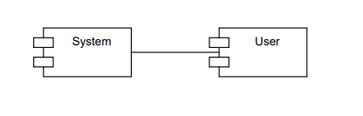
Component Diagram:
A component diagram, also known as a UML component diagram, describes the organization and wiring of the physical components in a system. Component diagrams are often drawn to help model implementation details and double-check that every aspect of the system's required function is covered by planned development.
Figure: Component diagram

Slide 29
UML DIAGRAMS
ER Diagram:
An Entity–relationship model (ER model) describes the structure of a database with the help of a diagram, which is known as Entity Relationship Diagram (ER Diagram). An ER model is a design or blueprint of a database that can later be implemented as a database. The main components of E-R model are: entity set and relationship set.
An ER diagram shows the relationship among entity sets. An entity set is a group of similar entities and these entities can have attributes. In terms of DBMS, an entity is a table or attribute of a table in database, so by showing relationship among tables and their attributes, ER diagram shows the complete logical structure of a database. Let’s have a look at a simple ER diagram to understand this concept.

Slide 30
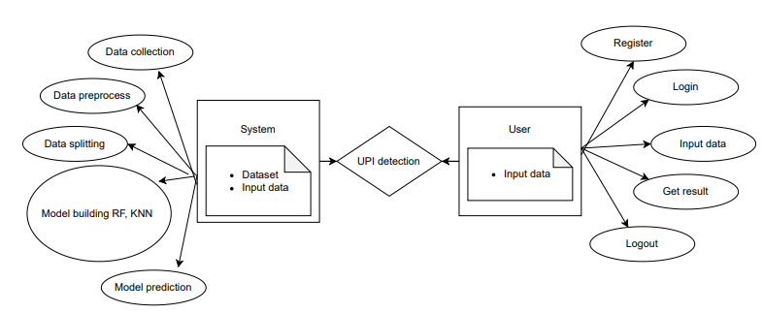
Figure: ER diagram

Slide 31
DFD Diagram:
A Data Flow Diagram (DFD) is a traditional way to visualize the information flows within a system. A neat and clear DFD can depict a good amount of the system requirements graphically. It can be manual, automated, or a combination of both. It shows how information enters and leaves the system, what changes the information and where information is stored. The purpose of a DFD is to show the scope and boundaries of a system as a whole. It may be used as a communications tool between a systems analyst and any person who plays a part in the system that acts as the starting point for redesigning a system.
dataset
system
user
Figure: Context Level diagram

Slide 32
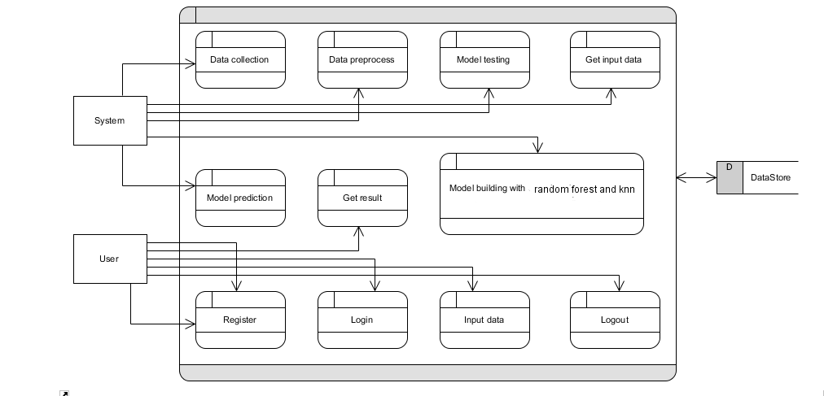
DFD Diagram:
Figure: Level 1 diagram

Slide 33
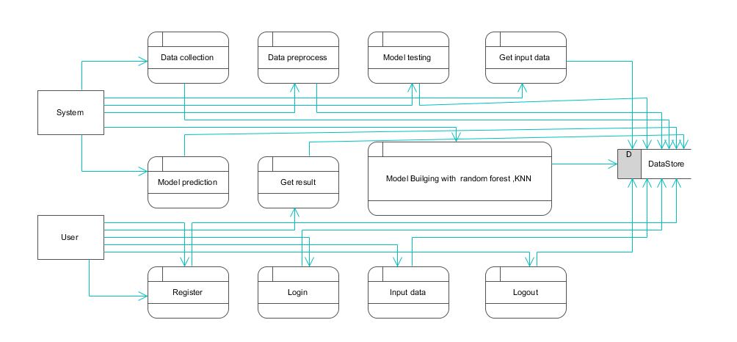
DFD Diagram:
Figure: Level 2 diagram

Slide 34
Pre-processing steps
Data Cleaning: Remove or impute missing values.
Feature Selection: Choose relevant features impacting hospital stay.
Data Transformation: Normalize or standardize numerical data.
Encoding Categorical Data: Use one-hot encoding or label encoding for categorical variables.
Data Splitting: Divide the dataset into training and testing sets.
Feature Engineering: Create new features that might improve model performance.

Slide 35
MODULES
1. User:
Input Model:
The user must provide input values for the certain fields in order to get results.
Upload dataset
View Results:
User view’s the generated results from the model.
View score:
Here user have ability to view the accuracy in %

Slide 36
2. System
2.1 Working on dataset: System checks for data whether it is available or not and load the data in csv files.
2.2 Pre-processing: Data need to be pre-processed according the models it helps to increase the accuracy of the model and better information about the data.
2.3 Training the data: After pre-processing the data will split into two parts as train and test data before training with the given algorithms.
2.4 Model Building: To create a model that predicts the personality with better accuracy, this module will help user.
2.5 Generated Score: Here user view the score in %

Slide 37
Algorithm Definition
Random Forest
Random Forest is an ensemble learning method that constructs multiple decision trees during training and outputs the mode of the classes (classification) or mean prediction (regression) of the individual trees. By combining the results of multiple trees, Random Forest improves prediction accuracy and robustness, reducing overfitting compared to a single decision tree.
k-Nearest Neighbors (k-NN):
k-Nearest Neighbors (k-NN) is a simple, yet powerful, non-parametric algorithm used for both classification and regression tasks in machine learning. It operates on the principle that similar data points are located close to each other in feature space. This algorithm is particularly useful for tasks where the decision boundary is irregular and cannot be easily defined by a linear equation.

Slide 38
Decision Tree
A decision tree is a non-parametric supervised learning algorithm. It has a hierarchical, tree structure, which consists of a root node, branches, internal nodes and leaf nodes.
Decision Trees are the foundation for many classical machine learning algorithms like Random Forests, Bagging, and Boosted Decision Trees. His idea was to represent data as a tree where each internal node denotes a test on an attribute (basically a condition), each branch represents an outcome of the test, and each leaf node (terminal node) holds a class label.

Slide 39
REFERENCES
1. ALESKEROV E, FREISLEBEN, B., and, RAO B (1997) CARDWATCH: A neural network-based database mining system for credit card fraud detection. In Conference (pp. 220–226). IEEE, Piscataway, NJ
2. Sahin M (2017) Understanding Telephony Fraud as an Essential Step to Better Fight it [Thesis]. École Doctorale Informatique, Télécommunication et Électronique, Paris
3. Abdallah A, Maarof MA, Zainal A (2016) Fraud detection system: A survey. J Netw Comput Appl 68:90–113
4. ANDREWS PP, PETERSON MB (eds) (1990) Criminal Intelligence Analysis. Palmer Enterprises, Loomis, CA
5. ARTÍS M, AyUSO M, GUILLÉN M (1999) Modeling different types of automobile insurance fraud behavior in the Spanish market. Insurance Math Econ 24:67–81
6. BARAO MI, TAWN JA (1999) Extremal analysis of short series with outliers: Sea-levels and athletics records. Appl Stat 48:469–487 Page 14/16

Slide 40
7. BLUNT G, HAND DJ (2000) The UK credit card market. Technical report, Department of Mathematics, Imperial College, London
8. BOLTON RJ, HAND DJ (2001) Unsupervised profiling methods for fraud detection. In Conference on Credit Scoring and Credit Control 7, Edinburgh, UK, 5–7 Sept
9. Phua C, Lee V, Smith K, Gayler R (2010) A comprehensive survey of data mining-based fraud detection research. https://doi.org/10.48550/ARXIV.1009.6119
10. Summers SL, Sweeney JT (1998) Fraudulently misstated financial statements and insider trading: An empirical analysis. 73(1):131–146https://www.jstor.org/stable/248345

